Slide 1
Software Engineering Practices

Slide 2
Plan
Quick presentation of ideas
Split into groups focusing on GitHub or Python
Plan for your own group work

Slide 3
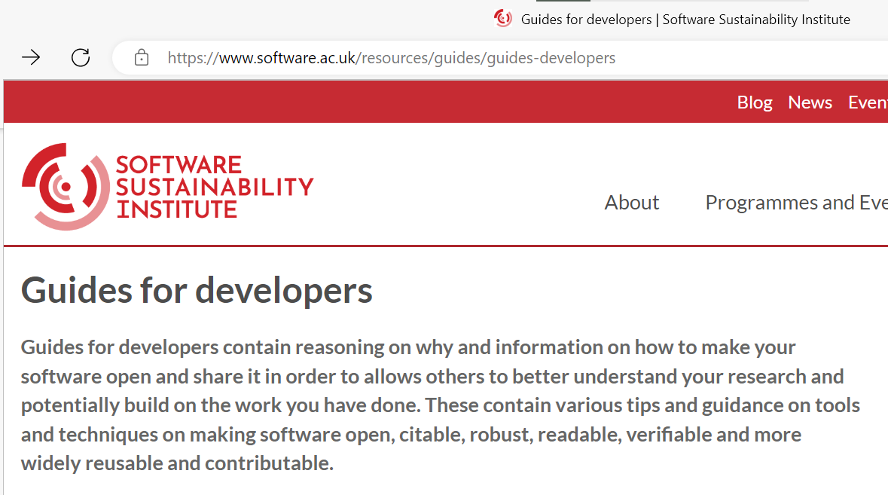
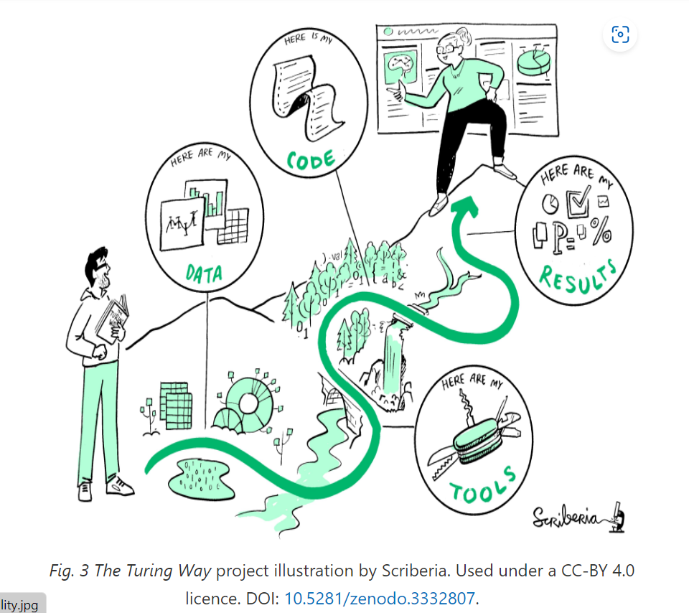
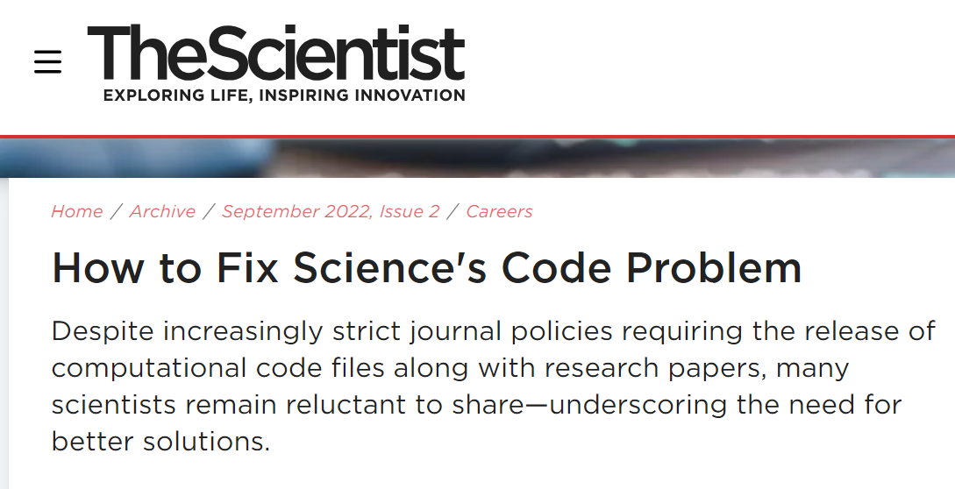
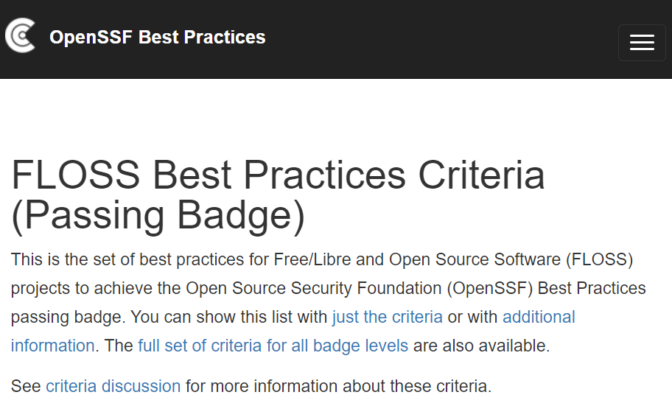
Community Practice

Slide 4
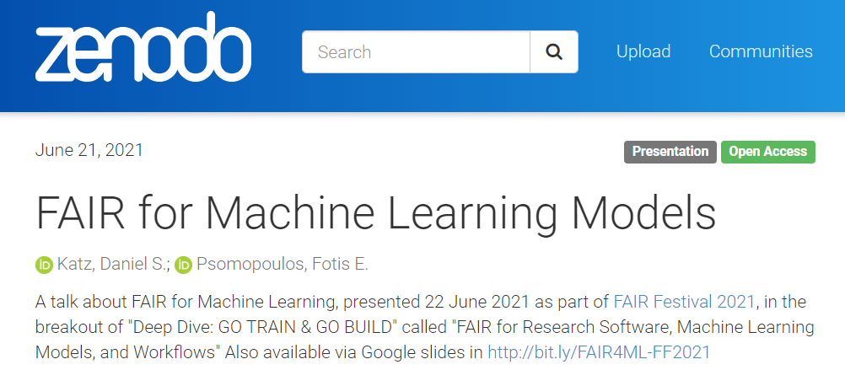
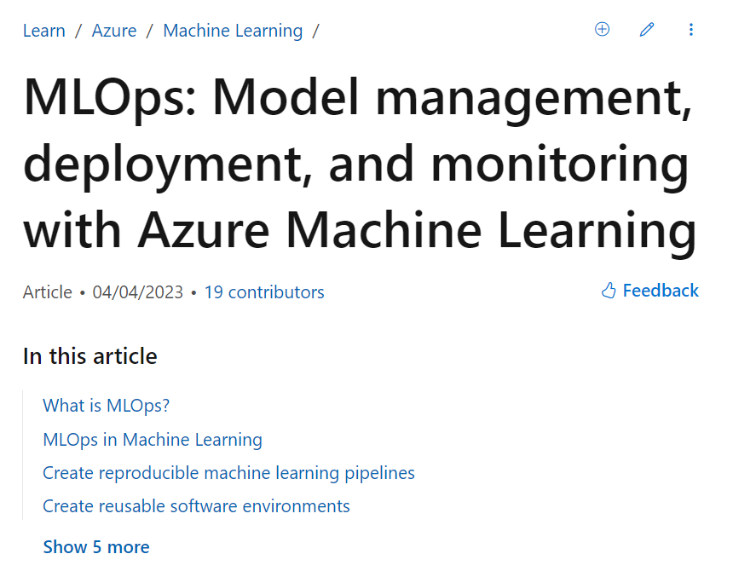
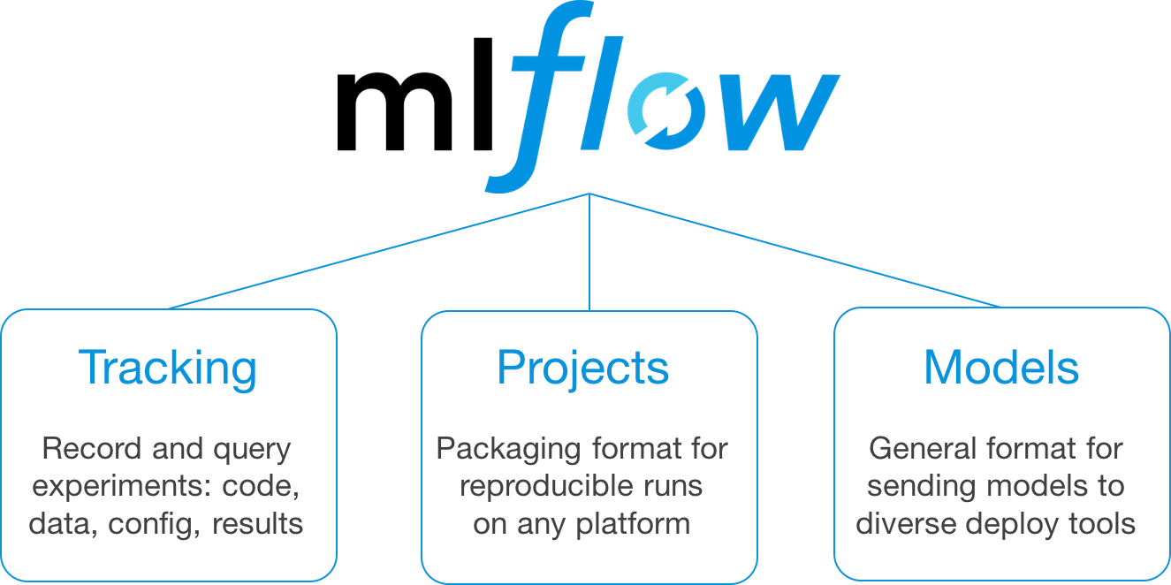
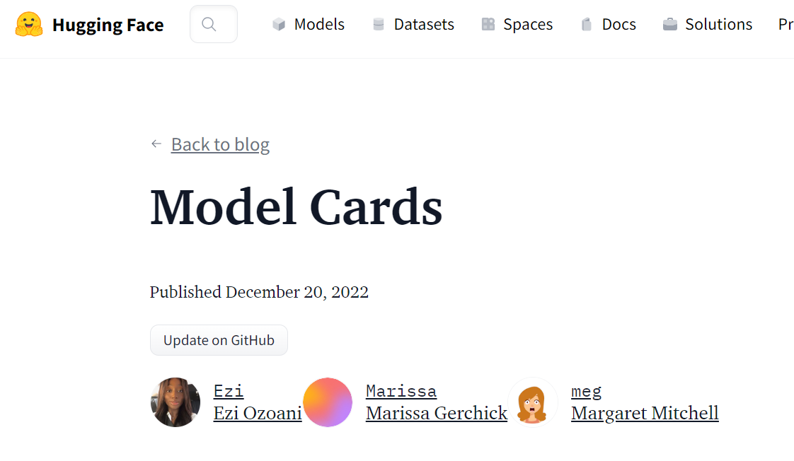
Community Practice

Slide 5
Community practice
Software development is often a social process and… a social good
Requires good technical and social practices (e.g., writing clean code, testing output, documentation, code reviews, collaboration)
Tools, infrastructure and existing open practice
Sustainable software

Slide 6
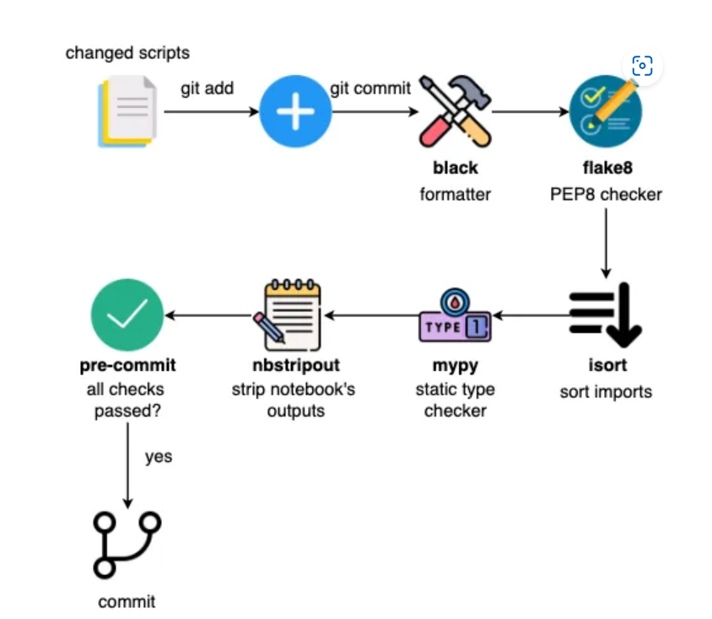
Python
How to Structure a Data Science Project for Readability and Transparency | by Khuyen Tran | Towards Data Science

Slide 7
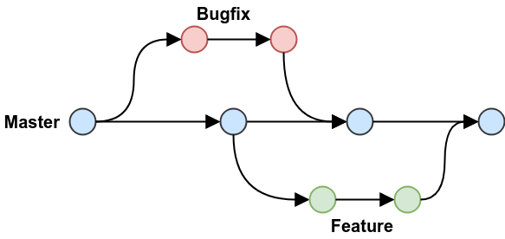
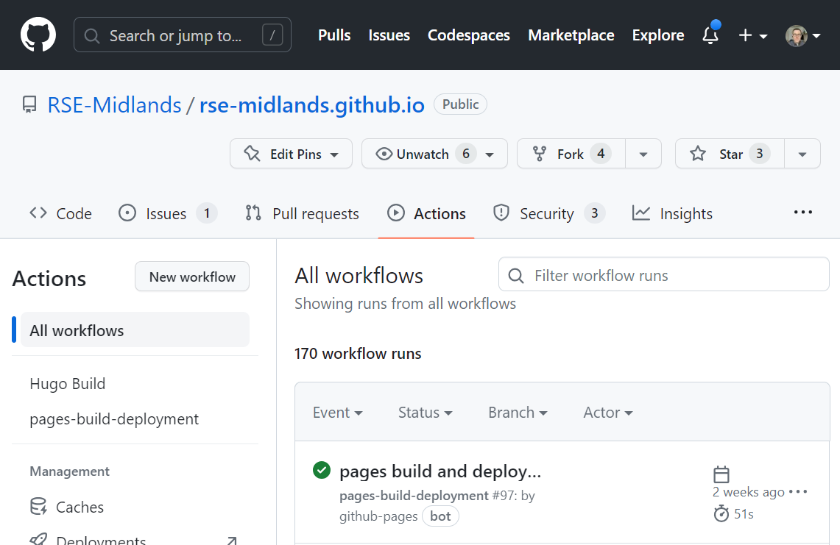
Git
GitHub flow - GitHub Docs
GitHub Actions Documentation - GitHub Docs

Slide 8
Group activity
Split into groups focusing on either GitHub or Python practices
Choose one of the below repos
alan-turing-institute/sqlsynthgen: Synthetic data for SQL databases (github.com)
IN-CORE/pyincore
kaislar/ds_template (github.com)
MaartenGr/BERTopic at fca5a4f9df149609c7e3458d6b2c421194cea62c (github.com)
Consider critically the repo using the following questions for inspiration

Slide 9
Questions
In your groups:
What good practices are there?
Are there areas for improvement?
How might this help you inform your practice?
Be prepared to share your insights with the group

Slide 10
Feedback

Slide 11
Planning your practice (20 mins)
Building in good practices
Create a rough plan in your groups
Things to consider:
Automatic processes
How can you ensure quality?
Think about future you, your colleagues and the client. How can you help everyone through better practice?
Be prepared to feedback to the group

Slide 12
Feedback

Slide 13
Food for thought
Software is a social activity. Good practices ensure readable, maintainable and reliable software
Essential when shipping software which works and others can understand and build on
Some known good practices…

Slide 14
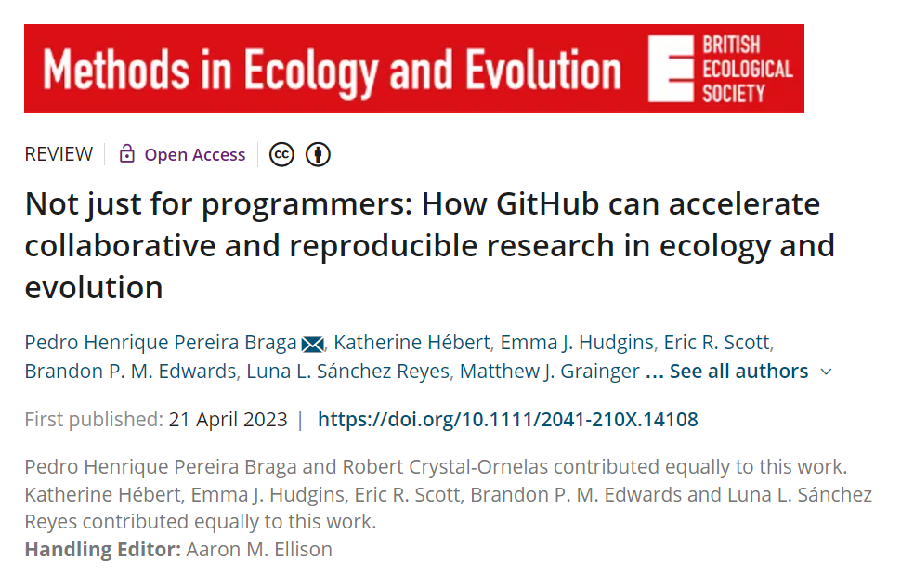
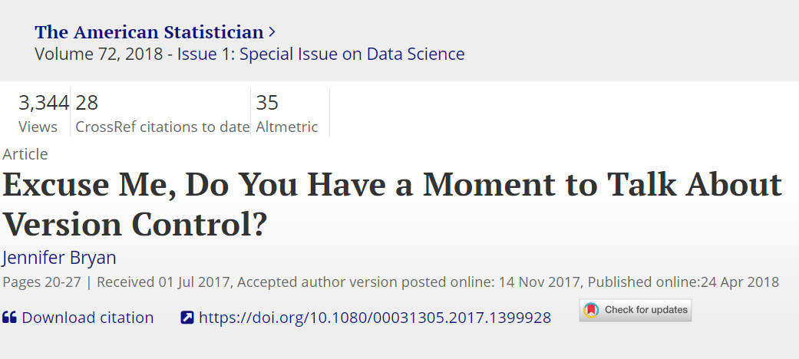
Some good practices
Code
Linting and formatting - Black 23.3.0 documentation, Linting Python in Visual Studio Code
Documentation standards - PEP 257 – Docstring Conventions | peps.python.org
Defensive programming – asserts, exception handling, data validation Decorators for Pipeline Integration - pandera
Capturing dependencies - Build your Python image | Docker Documentation, venv,
Coding documentation – Sphinx autosummary (repo example), PyCon – automate with sphinx and github actions
Packaging Setuptools, Packaging and Publishing with Python (carpentries-incubator.github.io)
Git platform (Github.com, GitTea)
Precommit hooks - pre-commit - Pre-commit : Protecting your future self (ns-rse.github.io)
Issues and project management
Code branching, protected main branch
Informative commit messages
Sensible repo templates data science site:github.com "Public template" - Google Search
Project documentation
Actions (CI/CD) automation of tests (before committing to main) and other CI/CD processes GitHub Marketplace · Actions to improve your workflow
Data Science
Data versioning and workflow capture(DVC) Data Version Control · DVC
Recording ML work (mlflow)

Slide 15
Your practice
Proto workflow
Sane folder structure – Template repository
Documentation – README
Reproducible coding environment (Docker, virt env, conda)
Write clean and readable code matching existing standards - IDE features and reading
Write tests (pytest)
Informative commits to version control branches
Code review
Robust libraries
Aim for quality and sustainability

Slide 16
Next steps
Write a living document of your software practices
Build out infrastructure (IDE plugins, github actions, folder templates, etc.) to support those practices
Speak to your technical mentor and project managers

Slide 17
Data Science for Social Good
DSSGx UK Summer Fellowship

